Slide 1
Role of Artificial Intelligence in Traffic Optimization

Slide 2
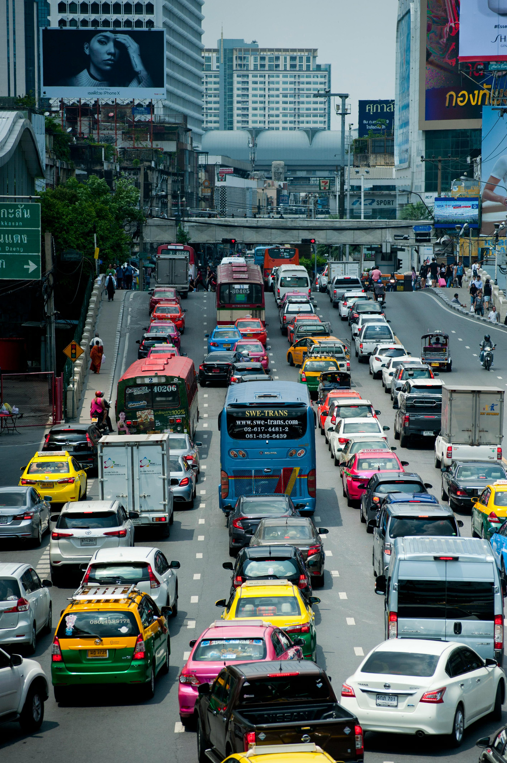
Introduction
  Urbanisation increases traffic congestion
  AI enables adaptive control
  DRL optimises traffic signals
  Pune faces severe congestion

Slide 3
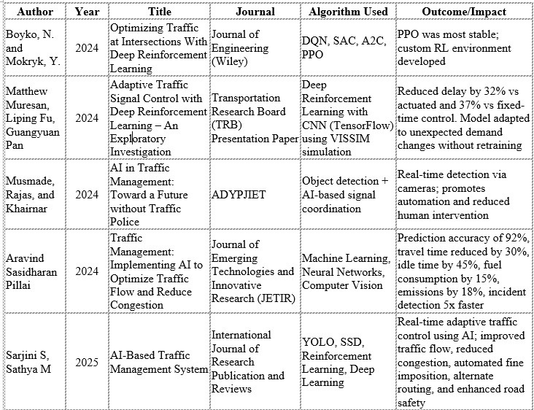
Literature Review

Slide 4


Methodology
Static baseline setup
Training protocol
testing protocol
RL controller development
reward function design
performance evaluation
Data & network Preparation
Data & network Preparation
Static baseline setup
RL controller development
reward function design
Training protocol
testing protocol
performance evaluation

Slide 5
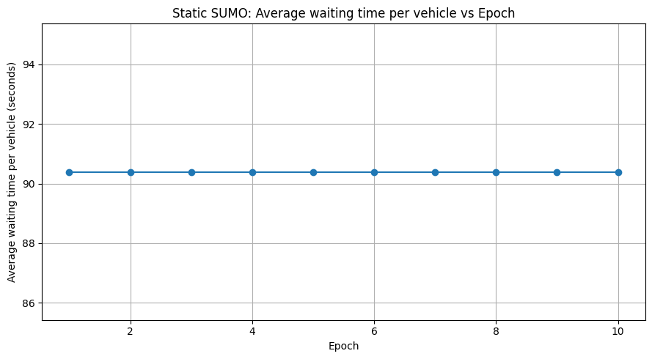
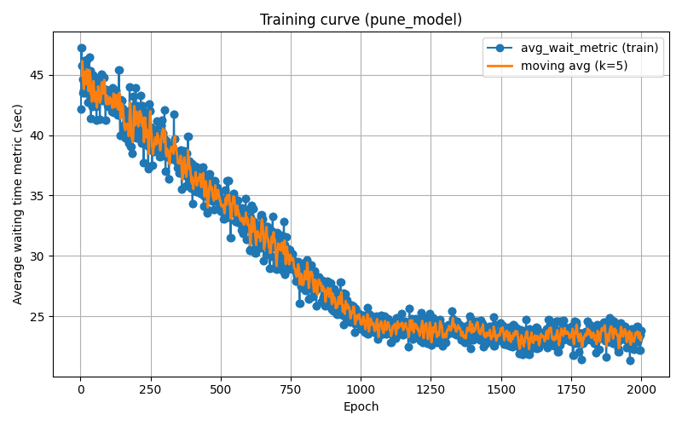
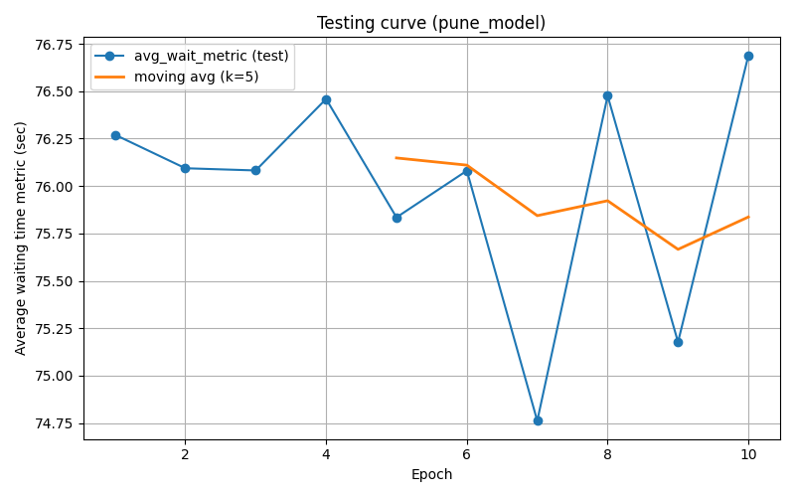
Experimental Result

Slide 6
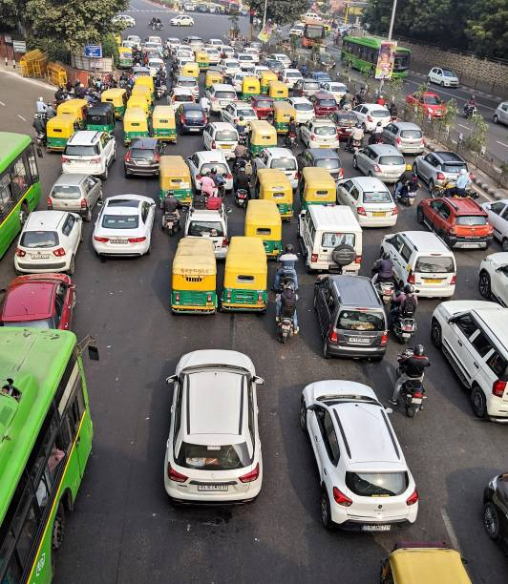
Conclusion
  Outperforms fixed-time static baseline
  Improves flow and emissions
  Scale with real-world data
  Model heterogeneous driver behavior

Slide 7
THANK YOU

